Slide 1

customer relationship management system give me for ppt
Supervisor Research Scholar
K.Dhanush
M.Suraj
Dr.Sudha Indiran
Designation RegNO:192110031,192110030
Institute of Institute of
Saveetha School of Engineering Saveetha School of Engineering
Notes:
1
1

Slide 2
Abstract
Customer Relationship Management (CRM) systems have become essential tools for businesses aiming to enhance their customer interactions and improve overall business efficiency. This presentation explores the concept of CRM, focusing on its importance, key features, and benefits for businesses of all sizes. It delves into the various types of CRM systems—operational, analytical, and collaborative—and explains how each contributes to sales, marketing, and customer service processes. Additionally, the presentation covers the CRM implementation process, highlighting common challenges such as data integration, user adoption, and cost concerns.

Slide 3
Introduction
Customer Relationship Management (CRM) refers to the practices, strategies, and technologies used by companies to manage and analyze customer interactions and data throughout the customer lifecycle. The goal is to improve business relationships, streamline processes, and ultimately increase profitability.
The stage for explaining the importance and functionality of CRM systems, as well as how they have evolved over time. It provides a more comprehensive understanding of CRM's role in driving business success.
A system and strategy used to manage and analyze customer interactions and data throughout the customer lifecycle.
Improve customer relationships, streamline business processes, and increase profitability.

Slide 4
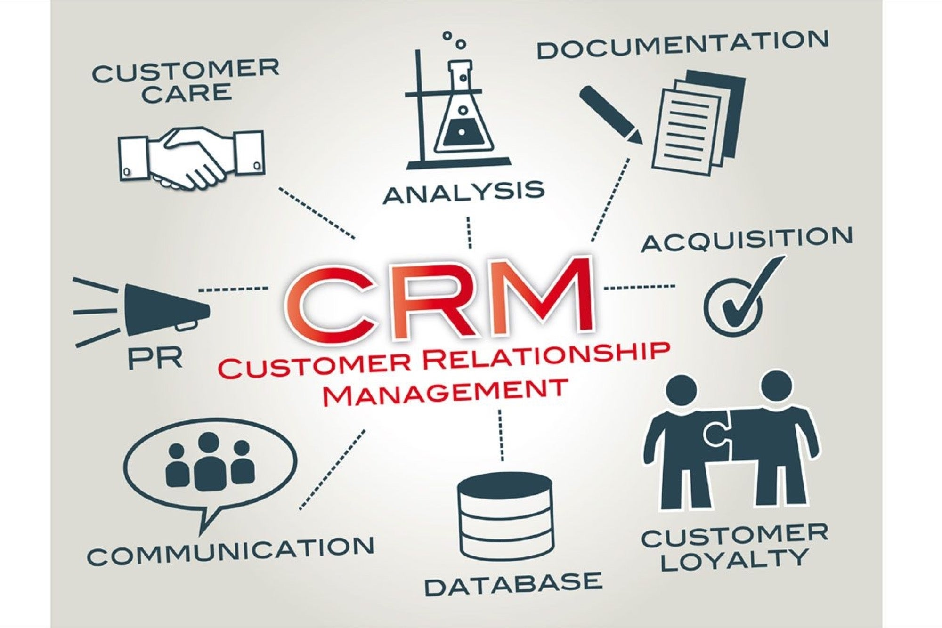

Slide 5
Key Features
Centralized database for customer details and interactions.
Tracks sales activities, leads, and opportunities.
Automates marketing campaigns, emails, and lead nurturing.
Manages inquiries, complaints, and service requests.
Provides insights on customer behavior and sales trends.
Improves communication across sales, marketing, and support teams.

Slide 6
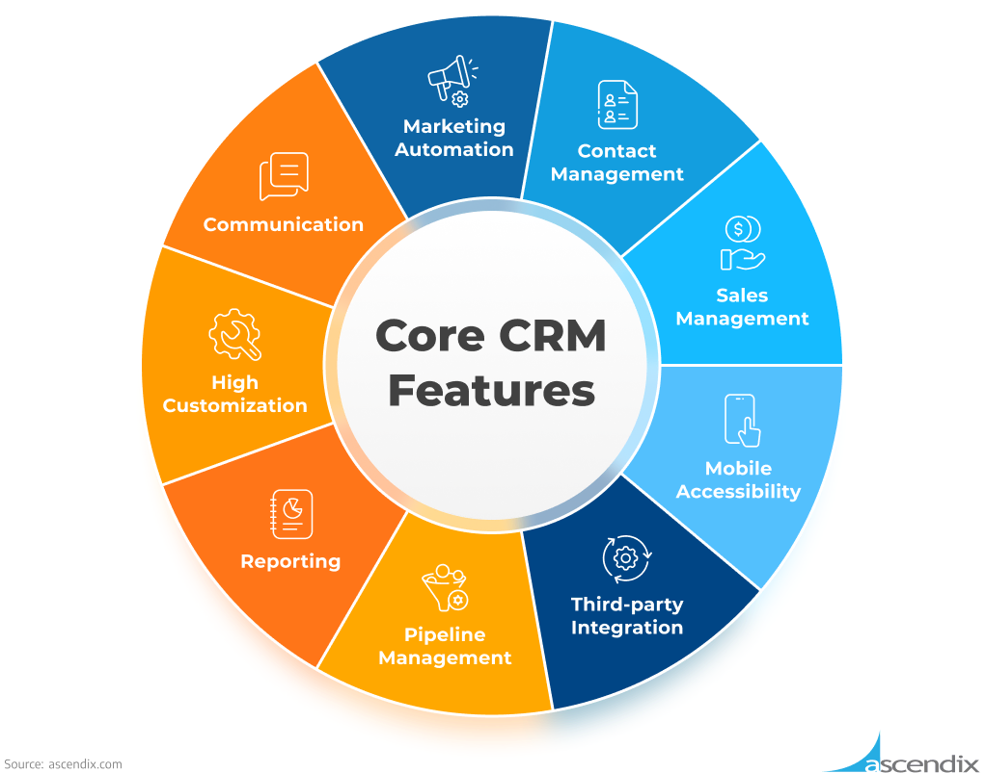

Slide 7
Proposed Aim
The aim of this presentation is to provide an in-depth understanding of Customer Relationship Management (CRM) systems, focusing on their key features, benefits, and how they help businesses enhance customer relationships, streamline operations, and boost overall performance. We will explore the various types of CRM systems, their implementation processes, and the latest trends that drive success in today’s competitive business environment.

Slide 8
Objectives
Provide a clear understanding of what CRM is and its role in improving customer relationships and business efficiency.
Centralized database to store and manage customer information
Automates campaigns, email marketing, and social media efforts to nurture leads and increase conversions.

Slide 9



Slide 10
Challenges in CRM Implementation
Employees may be reluctant to use the new CRM system, especially if they are accustomed to previous methods of managing customer relationships
Customizing a CRM to fit a company's exact needs can be costly, requiring additional development and resources.
CRM systems, especially for large businesses, can require significant upfront investment, including software licenses, implementation costs, and system configuration.
To keep the CRM system functional and up-to-date, businesses need to budget for ongoing maintenance, software updates, and possibly hardware upgrades.

Slide 11
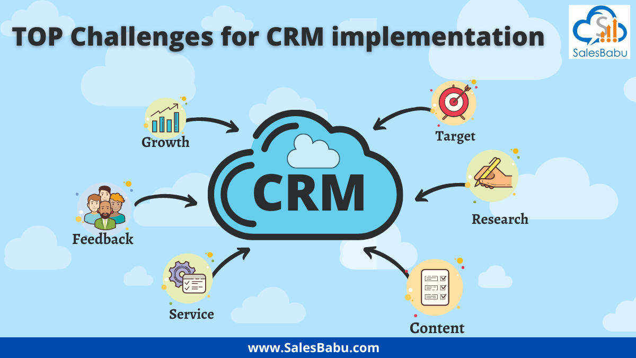

Slide 12
Conclusion
In conclusion, Customer Relationship Management (CRM) systems play a pivotal role in today’s business environment by helping companies manage and nurture customer relationships more effectively. Through their key features, such as customer data management, sales tracking, marketing automation, and customer service support, CRMs enable businesses to streamline operations, enhance customer satisfaction, and drive growth.
Additionally, as CRM technology continues to evolve with trends like artificial intelligence, mobile accessibility, and omnichannel strategies, companies can continue to stay competitive and relevant in a rapidly changing market.

Slide 13
References
Chalmeta, R. (2006). "Methodology for Customer Relationship Management." Journal of Information and Knowledge Management Systems, 36(3), 413-434. DOI: 10.1108/13673270610678822
Buttle, F. (2009). "Customer Relationship Management: Concepts and Technologies." 2nd Edition. Butterworth-Heinemann. ISBN: 978-1856176203
Payne, A., & Frow, P. (2005). "A Strategic Framework for Customer Relationship Management." Journal of Marketing, 69(4), 167-176. DOI: 10.1509/jmkg.69.4.167.60759
Greenberg, P. (2010). "CRM at the Speed of Light: Social CRM Strategies, Tools, and Techniques for Engaging Your Customers." 4th Edition. McGraw-Hill Education. ISBN: 978-0071742013

Slide 14


